Slide 1
Graphs 2

Slide 2

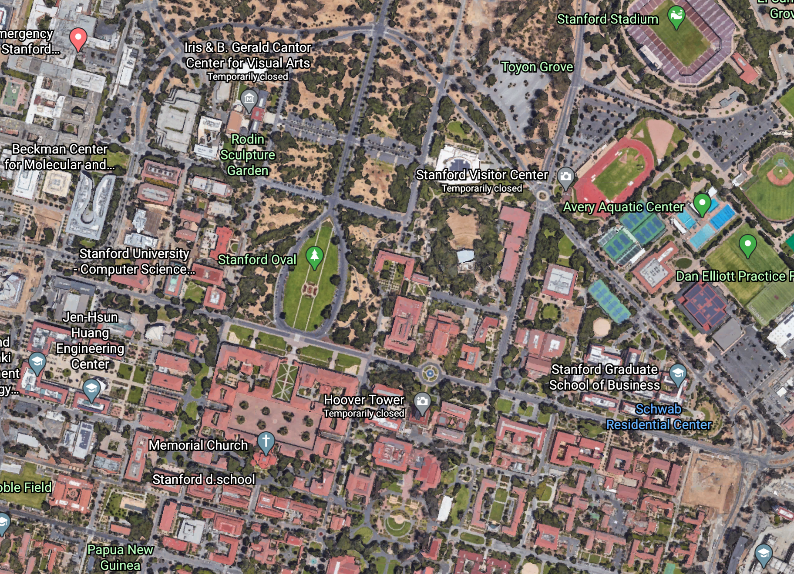
Recap: Graphs 1
We saw graphs: nodes and edges
We saw how they may be relevant for our drones
We saw some data structures for working with graphs, like queues

Slide 3
Today
Pathfinding: Search Algorithms
Breadth first
Depth first
Dijkstra’s
These algorithms let us do things search graphs

Slide 4
BREADTH FIRST SEARCH (BFS)

Slide 5
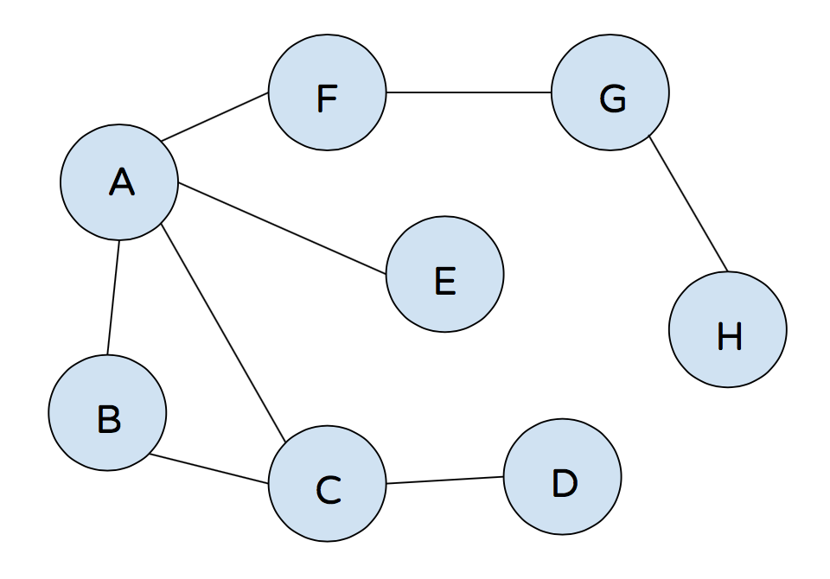
Breadth First Search (BFS)
Explore your graph based on number of edges from your starting point (source node)
Finds the shortest path between two nodes in unweighted, undirected graphs

Slide 6
BFS In Action
Source: A

Slide 7
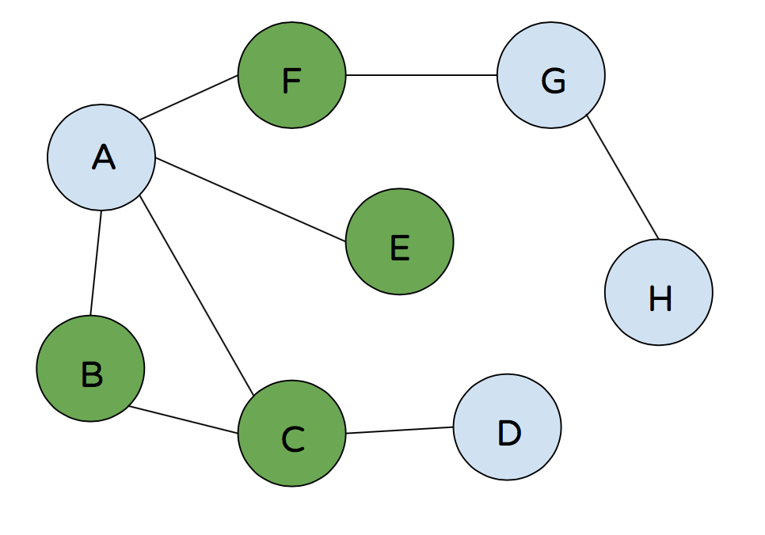
BFS In Action
Explore all nodes 1 edge away

Slide 8
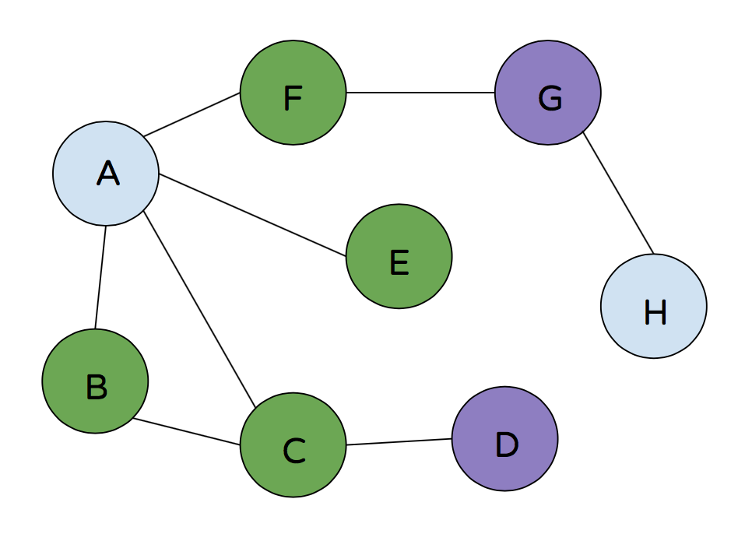
BFS In Action
Explore all nodes 2 edges away

Slide 9
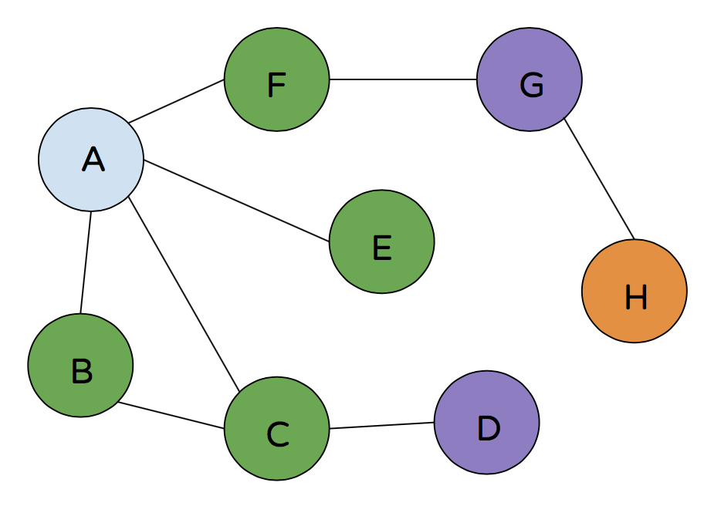
BFS In Action
Explore all nodes 3 edges away

Slide 10
BFS In Action
How does this help us find the shortest path from one node to another?
(Hint: What’s the shortest distance from A to D?)
Explore all nodes 3 edges away

Slide 11
How can we write clearly defined steps (an algorithm) to perform BFS?

Slide 12
The BFS Algorithm
Pick your source node and mark it as seen

Slide 13
BFS Example
Source: A
Target: H
Seen Nodes:
A (0)

Slide 14
The BFS Algorithm
Pick your source node and mark it as seen
Look at each of its adjacent nodes
If that adjacent node has not been seen before, push it onto the queue and mark it as seen

Slide 15
BFS Example
Source: A
Target: H
Seen Nodes:
A (0) B(1) C(1) E(1) F(1)
Queue:
B C E F

Slide 16
The BFS Algorithm
Pick your source node and mark it as seen
Look at each of its adjacent nodes
If that adjacent node has not been seen before, push it onto the queue and mark it as seen
Pop the node that’s at the front of the queue

Slide 17
BFS Example
Source: A
Target: H
Seen Nodes:
A (0) B(1) C(1) E(1) F(1)
Queue:
C E F
Popped Node:
B

Slide 18
The BFS Algorithm
Pick your source node and mark it as seen
Look at each of its adjacent nodes
If that adjacent node has not been seen before, push it onto the queue and mark it as seen
Pop the node that’s at the front of the queue
Repeat step 2 and 3 with the popped node, until:
There are no more nodes in the queue, or
You’ve found the target node you were looking for

Slide 19
BFS Example
Source: A
Target: H
Seen Nodes:
A (0) B(1) C(1) E(1) F(1)
Queue:
C E F
Popped Node:
B

Slide 20
BFS Example
Source: A
Target: H
Seen Nodes:
A (0) B(1) C(1) E(1) F(1)
Queue:
E F
Popped Node:
C

Slide 21
BFS Example
Source: A
Target: H
Seen Nodes:
A (0) B(1) C(1) E(1) F(1) D(2)
Queue:
E F D
Popped Node:
C
D

Slide 22
BFS Example
Source: A
Target: H
Seen Nodes:
A (0) B(1) C(1) E(1) F(1) D(2)
Queue:
F D
Popped Node:
E
D

Slide 23
BFS Example
Source: A
Target: H
Seen Nodes:
A (0) B(1) C(1) E(1) F(1) D(2)
Queue:
D
Popped Node:
F
D

Slide 24
BFS Example
Source: A
Target: H
G
Seen Nodes:
A (0) B(1) C(1) E(1) F(1) D(2) G(2)
Queue:
D G
Popped Node:
F
D

Slide 25
BFS Example
Source: A
Target: H
G
Seen Nodes:
A (0) B(1) C(1) E(1) F(1) D(2) G(2)
Queue:
G
Popped Node:
D
D

Slide 26
BFS Example
Source: A
Target: H
G
Seen Nodes:
A (0) B(1) C(1) E(1) F(1) D(2) G(2)
Queue:
[empty]
Popped Node:
G
D

Slide 27
BFS Example
Source: A
Target: H
G
Seen Nodes:
A (0) B(1) C(1) E(1) F(1) D(2) G(2) H(3)
Queue:
H
Popped Node:
G
H
D

Slide 28
BFS Example
Source: A
Target: H
G
Seen Nodes:
A (0) B(1) C(1) E(1) F(1) D(2) G(2) H(3)
Queue:
[empty]
Popped Node:
H
H
D

Slide 29
Exercise
Take a look at how BFS works, compared to a different search algorithm called DFS:
https://cs.stanford.edu/people/abisee/tutorial/bfsdfs.html

Slide 30
DIJKSTRA’S SHORTEST PATH ALGORITHM

Slide 31
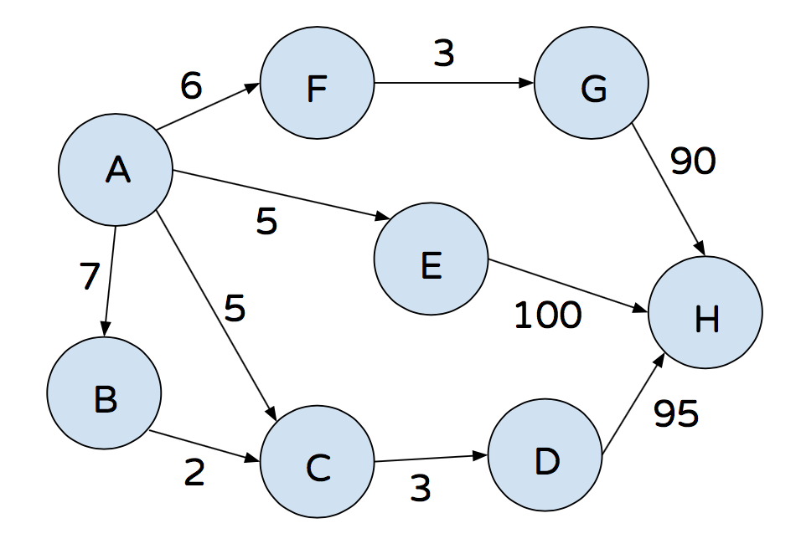
Dijkstra’s Algorithm
Extends BFS to find the shortest path in weighted graphs

Slide 32
Dijkstra’s Algorithm
Extends BFS to find the shortest path in weighted graphs
Question: what do the weights on a weighted graph represent?

Slide 33
Weighted Graphs
Answer: It depends! Weights can represent anything, like:
physical distance
time duration, or
monetary costs

Slide 34
Dijkstra’s Algorithm
Exactly the same as BFS, except we use a different data structure called a priority queue
In a priority queue, items are given a priority number, and items with the lowest priority number are removed first
Imagine a line where people with lowest priority number get to go to the front first
We have to now keep track of two things: the value of the item and its priority

Slide 35
Dijkstra’s Algorithm
For Dijkstra’s Algorithm, we keep track of new nodes in our priority queue
The total weight/distance/cost to travel from the source node to that node is its priority
We will explore nodes with the least distance first, just like in BFS
As we traverse the graph, we will update the total distance to unexplored nodes
Does not work for graphs with negative weights

Slide 36
Dijkstra’s Algorithm Example
Source: A
Find the shortest path to H.

Slide 37
Dijkstra’s Algorithm Example
Source: A
Find the shortest path to H.
Currently Exploring:
A(0)
Priority Queue:
[empty]
Finished Exploring:

Slide 38
Dijkstra’s Algorithm Example
Source: A
Find the shortest path to H.
Currently Exploring:
A(0)
Priority Queue:
C(5) E(5) F(6) B(7)
Finished Exploring:

Slide 39
Dijkstra’s Algorithm Example
Source: A
Find the shortest path to H.
Currently Exploring:
Priority Queue:
C(5) E(5) F(6) B(7)
Finished Exploring:
A(0)

Slide 40
Dijkstra’s Algorithm Example
Source: A
Find the shortest path to H.
Currently Exploring:
C(5)
Priority Queue:
E(5) F(6) B(7)
Finished Exploring:
A(0)

Slide 41
Dijkstra’s Algorithm Example
Source: A
Find the shortest path to H.
Currently Exploring:
C(5)
Priority Queue:
E(5) F(6) B(7) D(8)
Finished Exploring:
A(0)

Slide 42
Dijkstra’s Algorithm Example
Source: A
Find the shortest path to H.
Currently Exploring:
E(5)
Priority Queue:
F(6) B(7) D(8)
Finished Exploring:
A(0) C(5)

Slide 43
Dijkstra’s Algorithm Example
Source: A
Find the shortest path to H.
Currently Exploring:
E(5)
Priority Queue:
F(6) B(7) D(8) H(105)
Finished Exploring:
A(0) C(5)

Slide 44
Dijkstra’s Algorithm Example
Source: A
Find the shortest path to H.
Currently Exploring:
F(6)
Priority Queue:
B(7) D(8) H(105)
Finished Exploring:
A(0) C(5) E(5)

Slide 45
Dijkstra’s Algorithm Example
Source: A
Find the shortest path to H.
Currently Exploring:
F(6)
Priority Queue:
B(7) D(8) G(9) H(105)
Finished Exploring:
A(0) C(5) E(5)

Slide 46
Dijkstra’s Algorithm Example
Source: A
Find the shortest path to H.
Currently Exploring:
B(7)
Priority Queue:
D(8) G(9) H(105)
Finished Exploring:
A(0) C(5) E(5) F(6)

Slide 47
Dijkstra’s Algorithm Example
Source: A
Find the shortest path to H.
Currently Exploring:
D(8)
Priority Queue:
G(9) H(105)
Finished Exploring:
A(0) C(5) E(5) F(6) B(7)

Slide 48
Dijkstra’s Algorithm Example
Source: A
Find the shortest path to H.
Currently Exploring:
D(8)
Priority Queue:
G(9) H(103)
Finished Exploring:
A(0) C(5) E(5) F(6) B(7)

Slide 49
Dijkstra’s Algorithm Example
Source: A
Find the shortest path to H.
Currently Exploring:
G(9)
Priority Queue:
H(103)
Finished Exploring:
A(0) C(5) E(5) F(6) B(7) D(8)

Slide 50
Dijkstra’s Algorithm Example
Source: A
Find the shortest path to H.
Currently Exploring:
G(9)
Priority Queue:
H(99)
Finished Exploring:
A(0) C(5) E(5) F(6) B(7) D(8)

Slide 51
Dijkstra’s Algorithm Example
Source: A
Find the shortest path to H.
Currently Exploring:
H(99)
Priority Queue:
[empty]
Finished Exploring:
A(0) C(5) E(5) F(6) B(7) D(8) G(9)

Slide 52
Dijkstra’s Algorithm Example
Source: A
Find the shortest path to H.
Finished Exploring:
A(0) C(5) E(5) F(6) B(7) D(8) G(9) H(99)
Shortest distance to H: 99
Shortest path to H: A->F->G->H

Slide 53
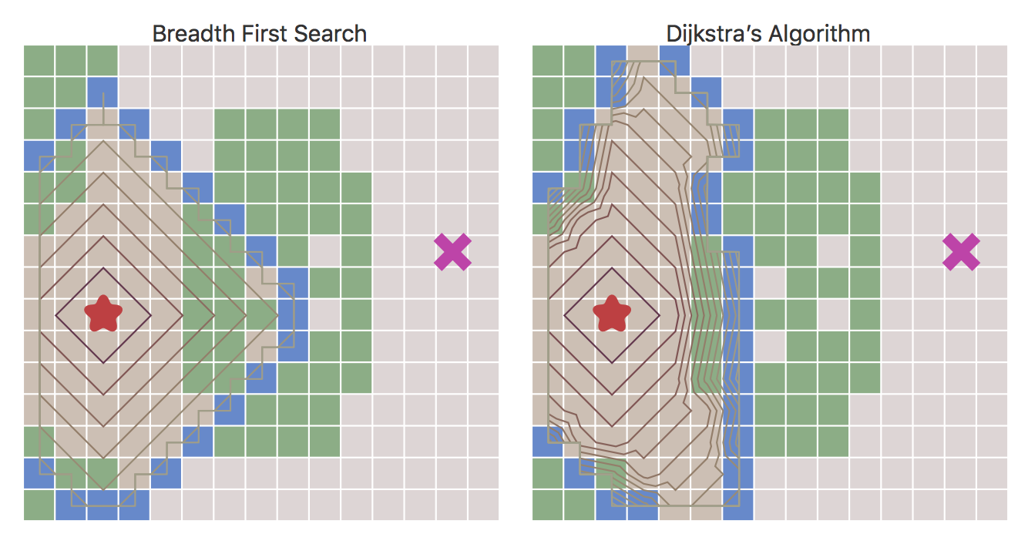
BFS vs Dijkstra’s

Slide 54
A*

Slide 55
Uninformed Search
BFS and Dijkstra’s are both uninformed searches

Slide 56
Uninformed Search
BFS and Dijkstra’s are both uninformed searches
They do not use problem-specific knowledge to do better

Slide 57
Uninformed Search
BFS and Dijkstra’s are both uninformed searches
They do not use problem-specific knowledge to do better
If we know something about a specific graph that could speed up our search, could we incorporate this information into our algorithm?

Slide 58
Speed Matters
For complex graph problems (like trying to find the shortest path on Google Maps), searching might take a lot of time
We don’t have unlimited time, so speed matters
We can develop heuristics to make our searches more efficient

Slide 59
Heuristics
A heuristic is a human-designed strategy used for solving a problem more quickly, by incorporating domain-specific knowledge (e.g. medicine vs games vs maps knowledge)
In the context of search algorithms:
Heuristics can help tell us where to search first, so we don’t waste time searching down paths we already expect to be high cost
Selecting what heuristic to use is a design choice
Heuristic design is also an important concept in deep learning, which is a hugely popular AI technique that is used in the newest AI technologies today

Slide 60
A*
A*: Extremely popular and powerful informed search algorithm
Same as Dijkstra’s with one addition: a heuristic cost
Minimizes the cost given by the graph (the weights we’ve seen before) and the cost given by our heuristic
If we pick a good heuristic, A* will always give the best solution to your pathfinding problem

Slide 61
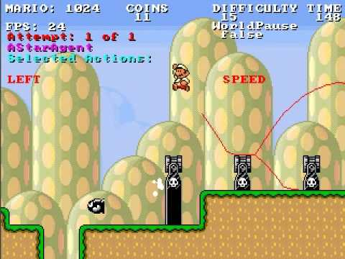
Example of A* on Super Mario

Slide 62
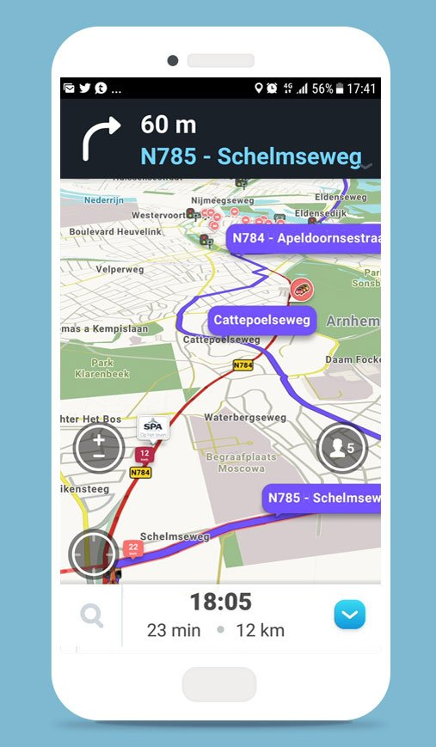
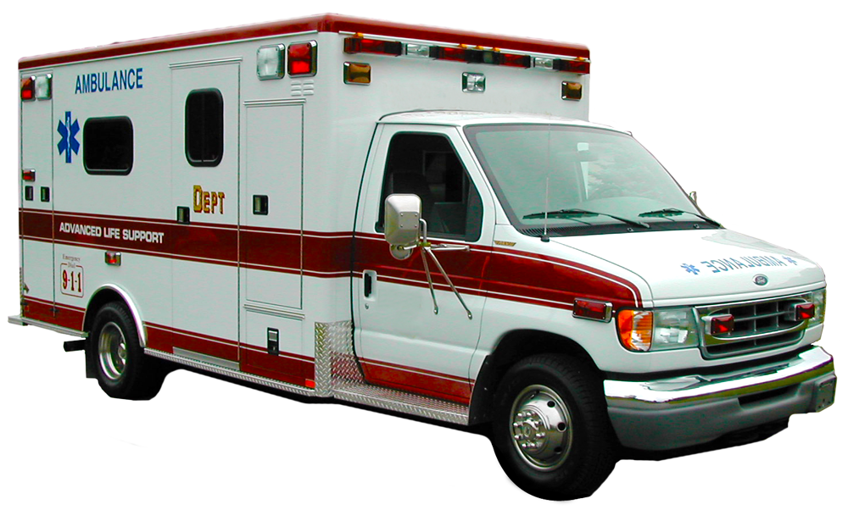
Human Decisions: Picking Heuristics
There is no single ‘correct’ heuristic to use
We pick heuristics based on what we find important for a specific problem
What sorts of ethical impacts could arise from heuristic selection for path finding problems?

Slide 63
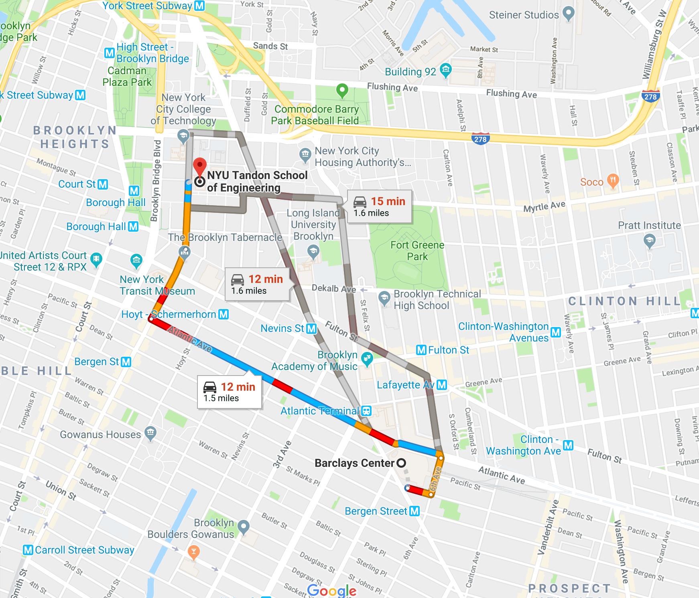
Key Terms
Data Structures
Queue
Priority Queue
BFS
DFS
Dijkstra’s Shortest Path Algorithm
A*

